Slide 1
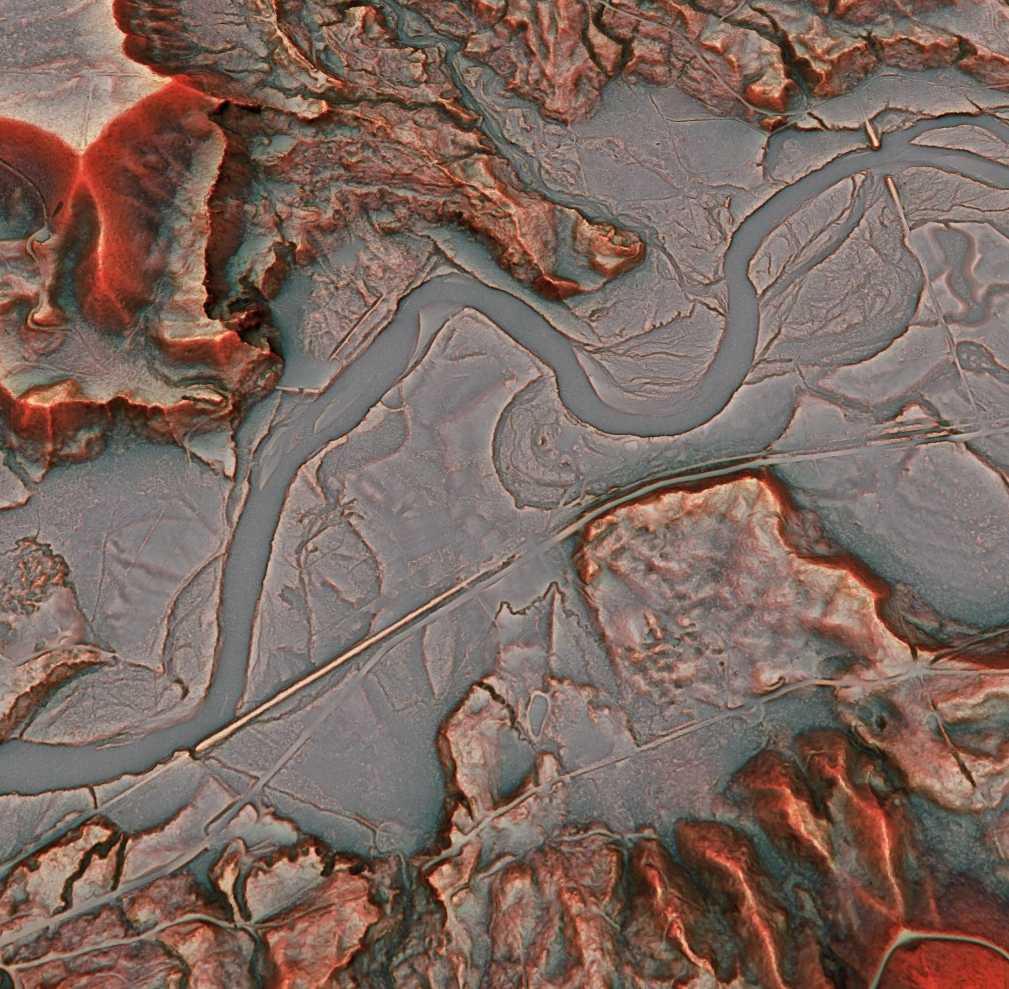
Red Relief Image Maps
RRIM

Slide 2
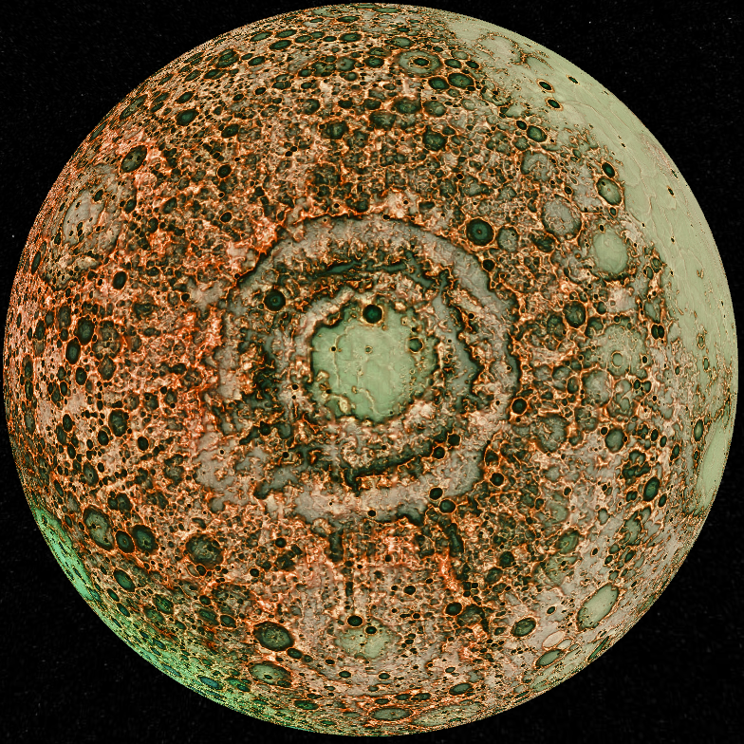
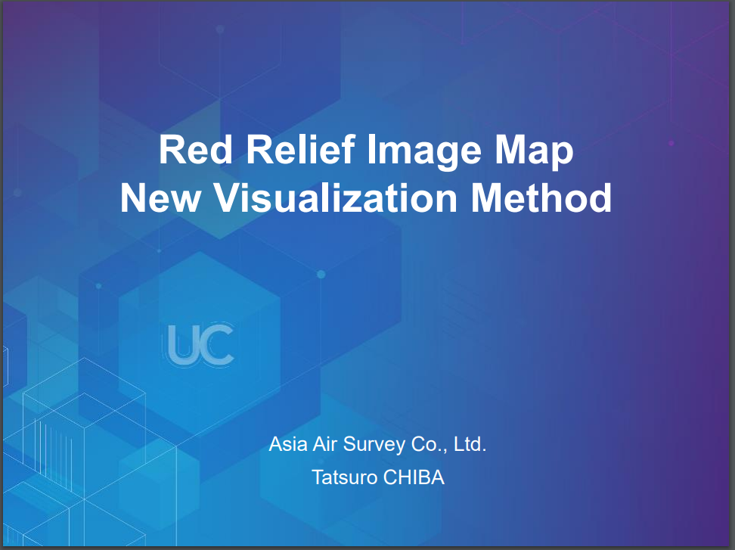
What are red relief image maps?
A new visualisation method
Please see the following presentation for background:
https://proceedings.esri.com/library/userconf/proc16/papers/446_644.pdf

Slide 3
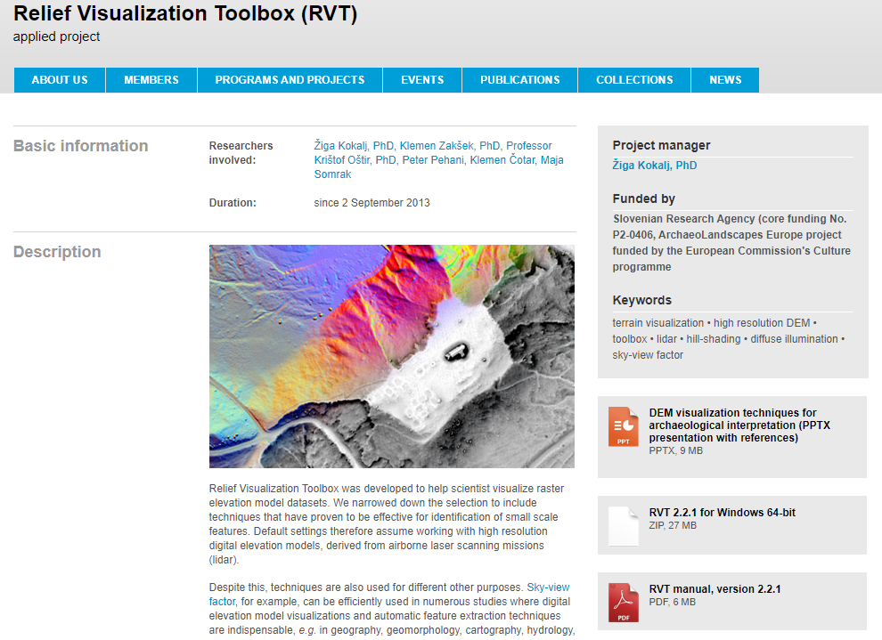
Downloads
RVT
https://iaps.zrc-sazu.si/en/rvt#v

Slide 4
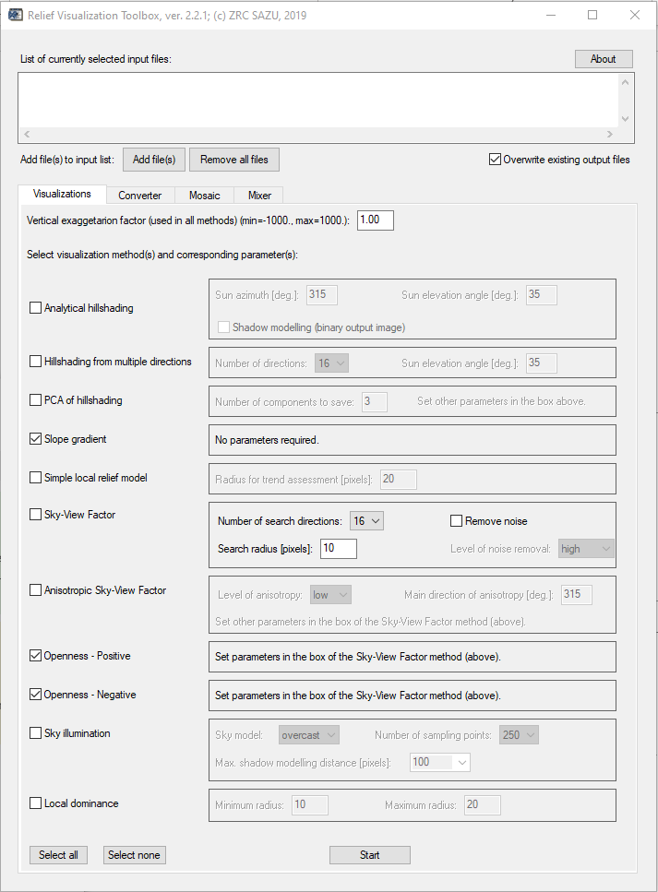
Relief Visualization Toolbox
1
Inputs
Run the IDL virtual machine
1. Add your bathymetry grid (.tif)
2. Check the boxes for Slope gradient, Openness – Positive and Openness – Negative
3. Parameters for Openness are set in the Sky-View Factor options. This is worth reading about in the documentation and experimenting with your own data to find the right search radius (know your raster resolution).
4. Start to begin processing
3
2
4

Slide 5
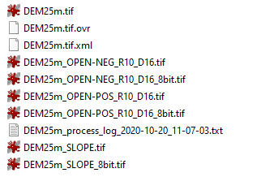
Relief Visualization Toolbox
Outputs
Files are saved in the same directory as source inputs.
Tool outputs will take the following naming convention:
“original name”_”output dataset”_”search radius”_”number of search directions”.tif
Files with “8bit” suffixes are not suitable for analysis and can be deleted.
Original data input
Outputs for analysis

Slide 6
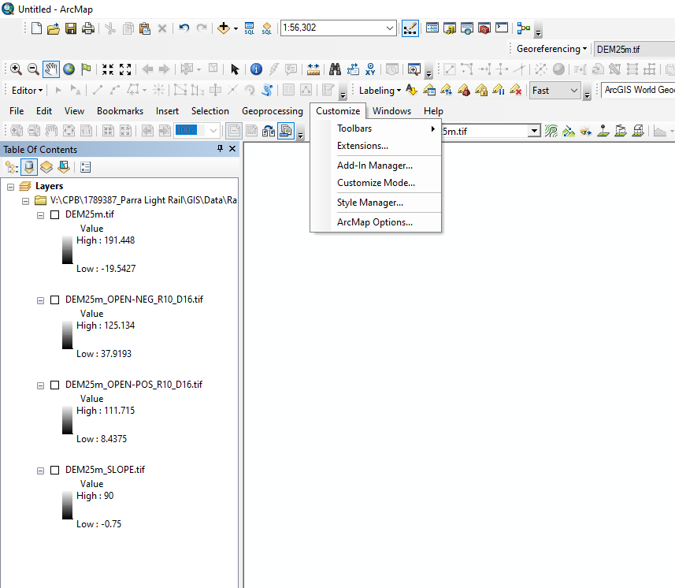
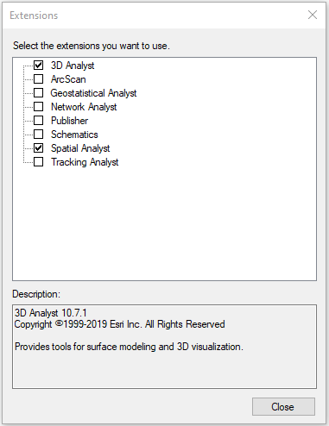
ArcMap
Raster calculations
Ensure extensions are enabled
Customize>Extensions…
Check that Spatial Analyst is ticked on
1
2

Slide 7
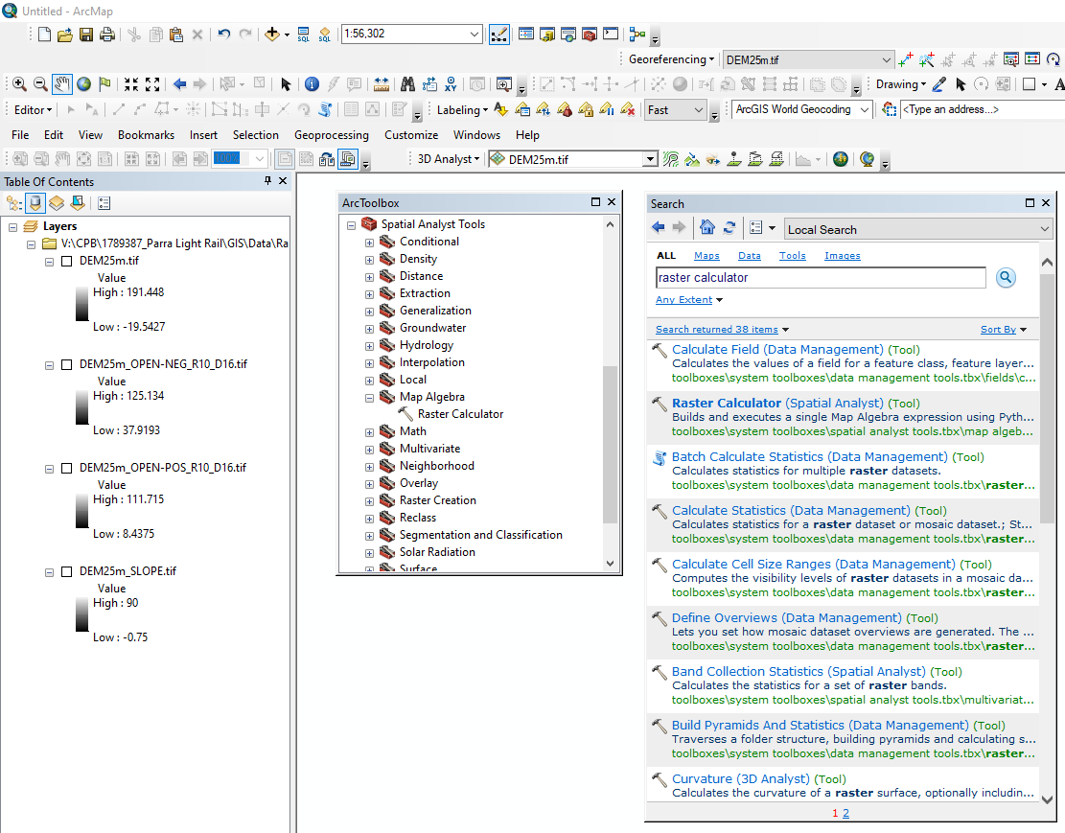
ArcMap
Raster calculations
Add your data for analysis to the map (an empty mxd is best if tools are failing).
Open the Raster Calculator geoprocessing tool from the ArcToolbox window or using Search window (ctrl+F).

Slide 8
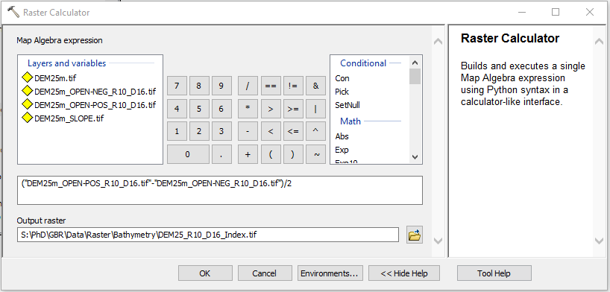
ArcMap
Raster calculations
RRIM index map = (O_{p} – O_{n})/2
Where O_{p} = Positive openness and O_{n} = Negative openness
2. Double click the corresponding rasters to add them to the expression field and use they keypad or keyboard to add the math symbols.
3. Save the output as “.tif” in the bathymetry folder (like all bathymetry derivatives).
2
1
3

